Slide 1
The Data Link Layer

Slide 2
Agenda
The data link layer
How to avoid collisions
Scaling up networks
The link layer addressing
IP addresses and Subnetting
IPv6 Subnetting
Devices in Link layer
Tasks for today
References
Questions

Slide 3
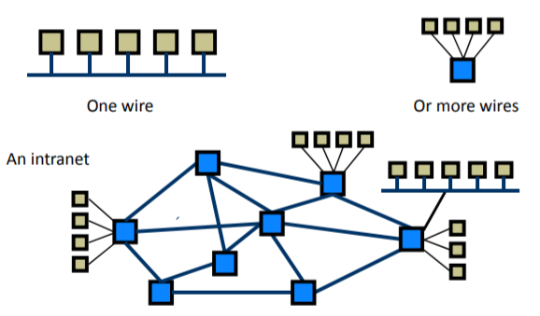

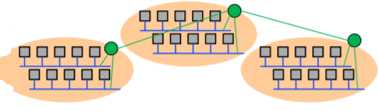
The data link layer
Media access control (MAC) and Logical link control (LLC) perform following actions:
Identifying packet/frame boundaries.
Error control.
Extending network size.
Control access to physical medium.
Addressing of destination stations.

Slide 4
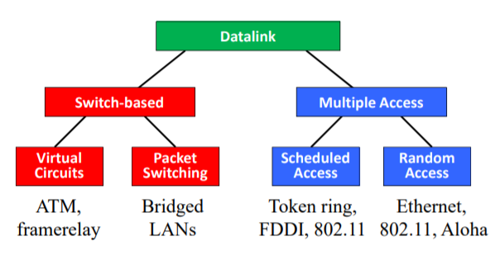
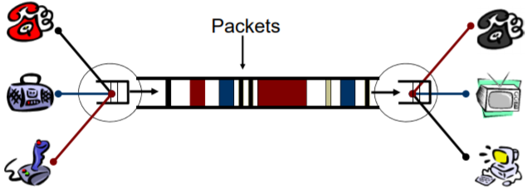
How to avoid collisions
Scheduling / Explicit coordination
Reservation systems
Pooling
Token ring
Random access (Send and hope to get lucky)
Natural scheme (listen before talk)
CSMA / CD, CSMA / CA

Slide 5
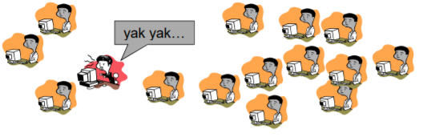
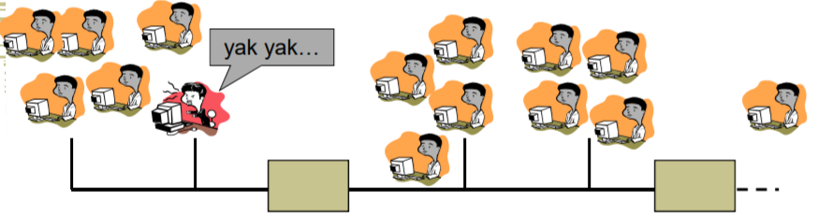
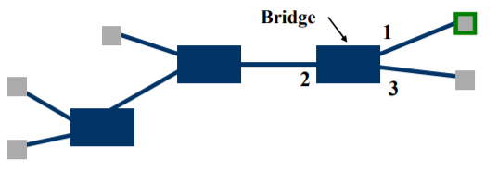
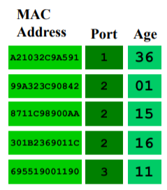
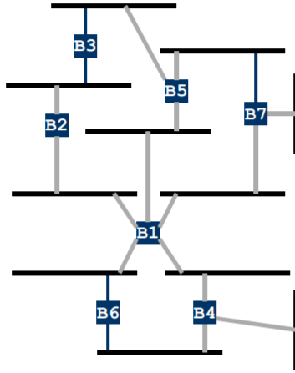
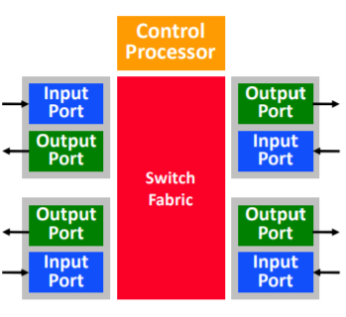
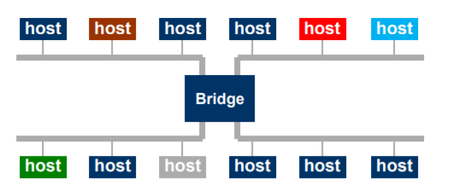
Scaling up networks

Slide 6
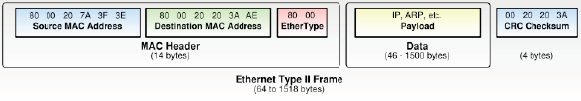
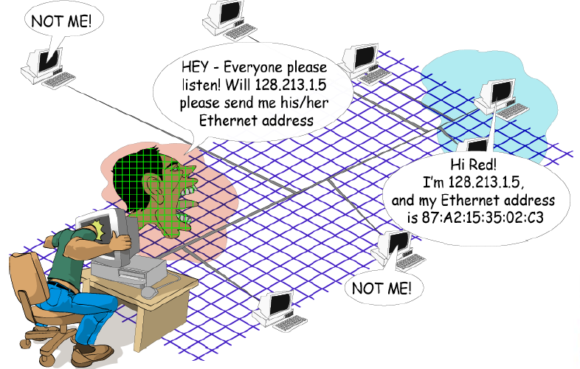
The Link level addressing

Slide 7
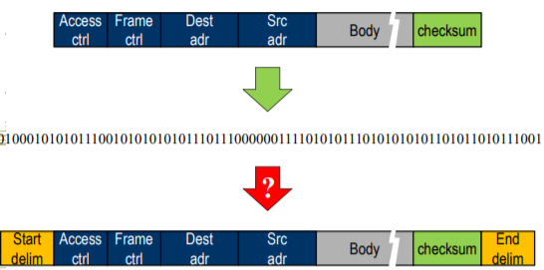
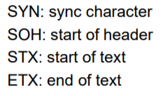

Framing

Slide 8
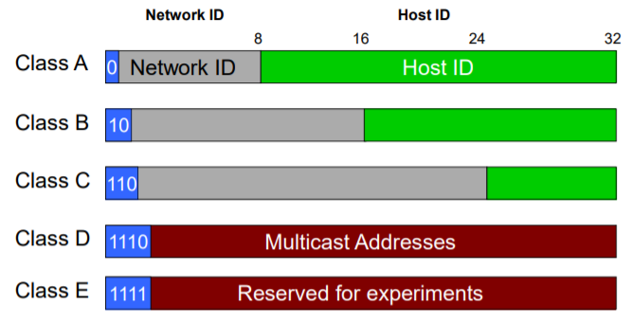
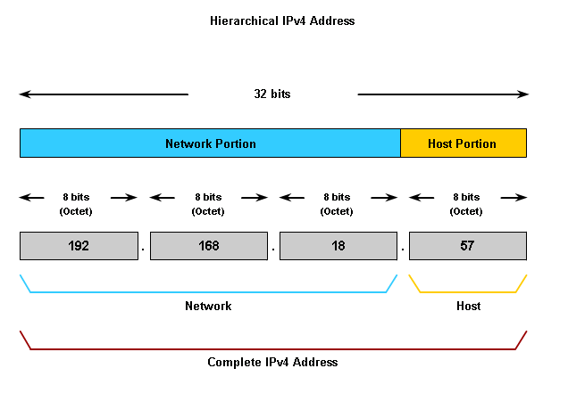
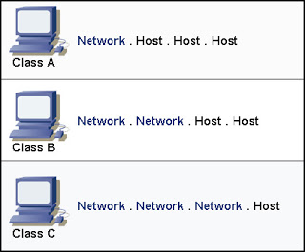
IP address

Slide 9
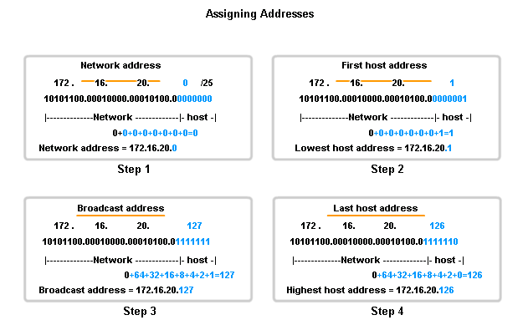
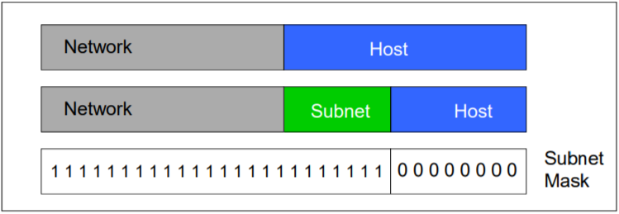
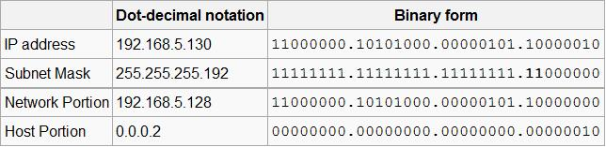
Subnetting

Slide 10
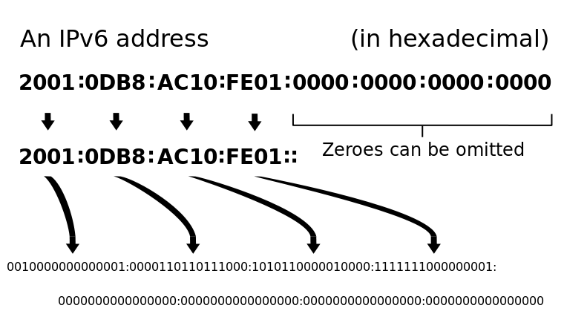
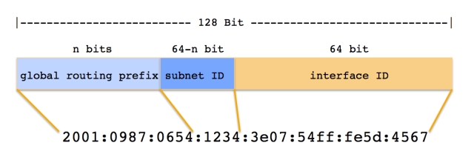
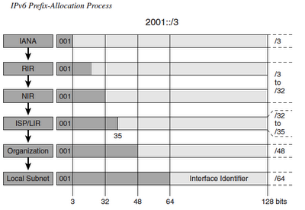
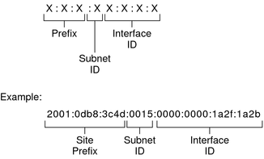
IPv6 Subnetting

Slide 11
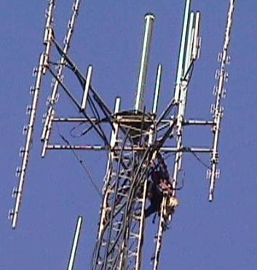
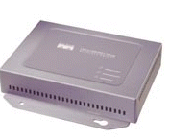
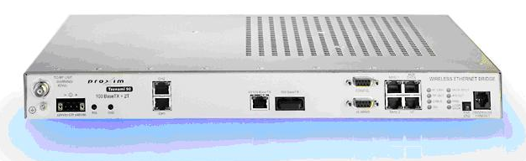
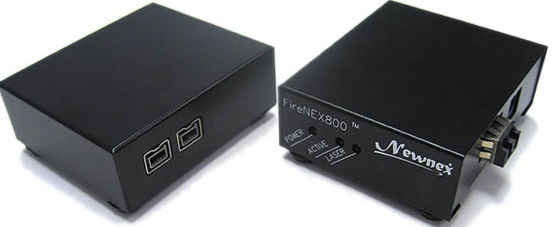
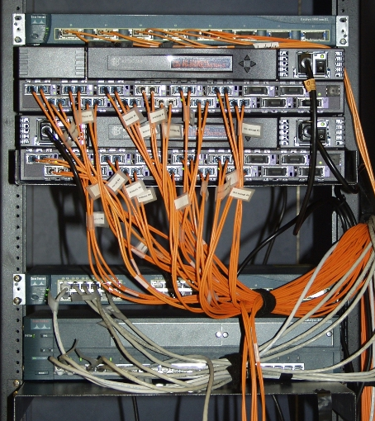
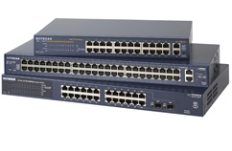
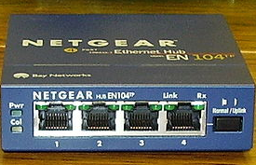
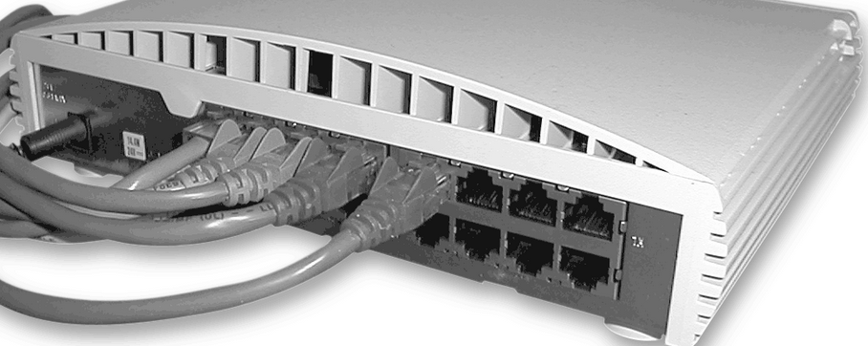
Devices in link layer
a. Repeaters
c. Network bridges
b. Hub
d. Network switches

Slide 12
Tasks for Today
Tasks for today:
Subnetting for given IPv4 addresses - first host, last host, broad cast, subnet mask.
Network tour identifying Link level devices.
Identifying all devices and mapping them to appropriate layer.
Network diagram of MSIT network, and how is it scaled with bridges
Wireshark task for analyzing Link layer frames.
Identifying ARP requests
MAC addresses of source and destination machines.
Link level frame analyzing with footer.

Slide 13
References
Wikipedia: Link layer, MAC, LLC.
Video on data link layer principles (MAC):https://www.youtube.com/watch?v=oeNHeixwKBI
Wireless Networks video: https://www.youtube.com/watch?v=cHU4G6uXwQY ,and https://www.youtube.com/watch?v=U8ruZ7nBjZM
Subnetting: https://en.wikipedia.org/wiki/Subnetwork
IPv6 subnetting: https://ipcisco.com/lesson/subnetting-in-ipv6/

Slide 14
Question and Answers (Q&A)
Thank you.

